Slide 1

Digital IC Design
Exercise 0
Design a 64-bit comparator
Professor Po-Tsang Huang
International College of Semiconductor Technology
National Yang Ming Chiao Tung University

Slide 2
Exercise
Design a 64-bit comparator
If (a==b) out = 1 else out = 0
The driving ability of all the inputs cannot be infinite.
Use vector file(pattern_array.vec) for your inputs
Implement this comparator in static CMOS circuit
Measure the propagation delay
Measure the leakage power

Slide 3
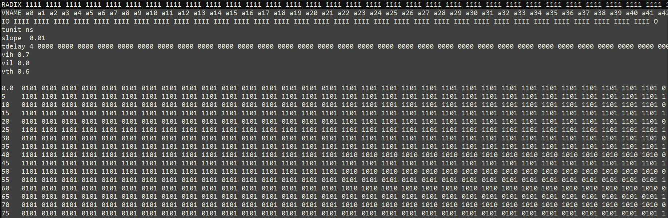
Test Pattern of 64bit Static CMOS
pattern_array.vec

Slide 4
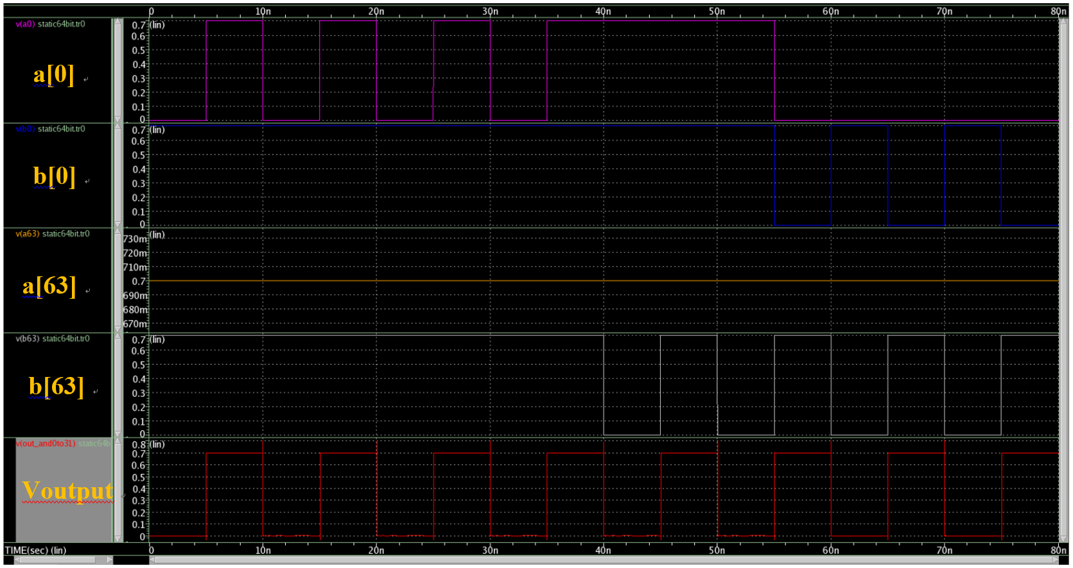
Static CMOS Waveform

Slide 5
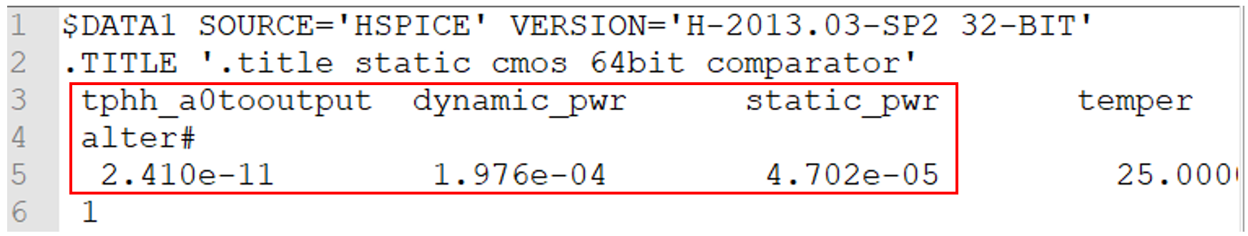
Delay Time and Power
.mt0 file

Slide 6
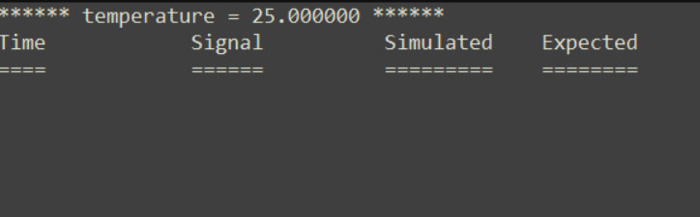
Check function right or false
.err0 file

